Slide 1
Global Azure Boot Camp – Twin Cities
Kevin Remde
Mike Benkovich
Katy Shimizu
Jerry Nettleton

Slide 2
Schedule
8:00 Setup
8:30 Welcome/Coffee/etc
9:00 Keynote Welcome to Azure
9:30 Azure Management tour (?)
10:00 App Services
11:00 Azure Functions
12:30 Docker & .NET Core
1:30 DevOps
2:30 Patterns
3:30 Raffle

Slide 3
Schedule Labs http://bit.ly/gabc17labs
8:00 Setup
8:30 Welcome/Coffee/etc
9:00 Keynote Welcome to Azure
9:30 Azure Management tour
10:00 App Services
11:00 Azure Functions
12:30 Docker & .NET Core
1:30 DevOps
2:30 Patterns
3:30 Raffle

Slide 4
Mike Benkovich
- Former Microsoft developer evangelist
- Live in Minneapolis
- Lead a Consulting practice at Imagine! Technologies
- Build Cloud, Mobile and DevOps practice centers
- Blog www.benkoTIPS.com
- Follow @mbenko on Twitter
- Send me Feedback! mike@benko.com

Slide 5
Subscriptions

Slide 6
Azure Subscriptions
An enrollment for Online Services for a defined Term as specified on the Portal
You may purchase multiple Subscriptions, which may be administered separately and which will be governed by the terms of a separate Microsoft Online Subscription Agreement
Owned by an individual or an organization
Enables provisioning of services within an Azure data center

Slide 7

Azure Subscriptions
Azure Free Account
$200 Credit for first 30 days
Access to free tier of services after 30 days
Cap prevents overage
Azure Benefits
MSDN : Up to $150/mo credit
BizSpark Plus : From $150/mo to $10,000/mo credit
Academic offers
Visual Studio Community + $25/mo for 1 year
Pay as you go
www.azure.com/free

Slide 8

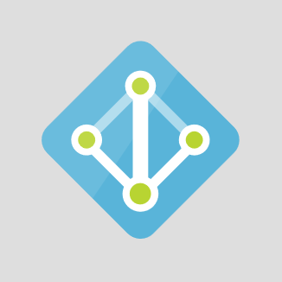
Security and Administration
Microsoft Accounts
Support Co-admin of all resources in subscription
Simple to admin in classic Azure portal
Azure Active Directory
Works with classic and modern Azure portals
Works with Azure Resource compatible services to support Role Based Access
Identity and Access Management (IAM)
Enables per service/per role authorization
Simple configuration
Requires Active Directory

Slide 9
Azure Active Directory
General
Overview
Quickstart
Manage
Users and Groups
Enterprise Applications
App Registrations
Application Proxy
Azure AD Connect
Domain Names
Mobility (MDM and MAM)
Password Reset
Company Branding
User Settings
Properties
Notification Settings
Conditional Access
Named Networks
Activity
Sign-ins - Audit Logs
Security
Users at Risk
Risky Sign-ins

Slide 10
Subscription Options
General
Overview
Access Control
Diagnose and solve
Billing
Invoices
Cost analysis
External Services
Payment methods
Partner info
Email my invoice
Settings
Programmatic Deployment
Resource Groups
Resources
Usage + Quotas
Management certificates
My permissions
Resource providers
Properties
Resource locks
Support + Troubleshooting
New support request

Slide 11
Provision subscription
Setup RBAC
Create user & login
Show dashboard

Slide 12
Portals

Slide 13
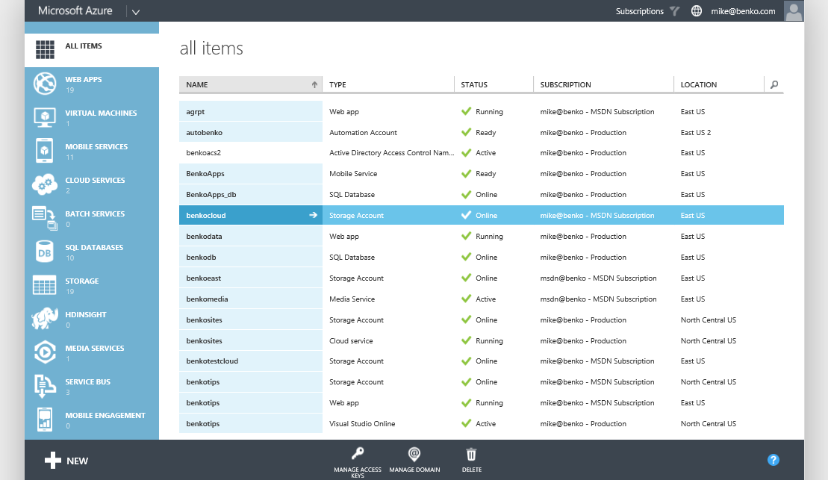
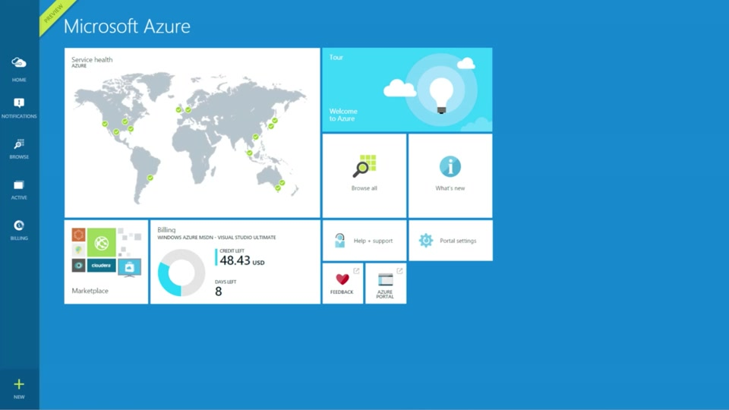
Get Started – Management Portals
manage.windowsazure.com
portal.azure.com
Subscription centric
Visibility of all resources
Contextual toolbars
Consistent create
Help system
Highly customizable
Search, Blades, and Lenses
Resource grouped provisioning
Role based access control (RBAC)
Advanced monitoring and troubleshooting
Self service ticketing

Slide 14
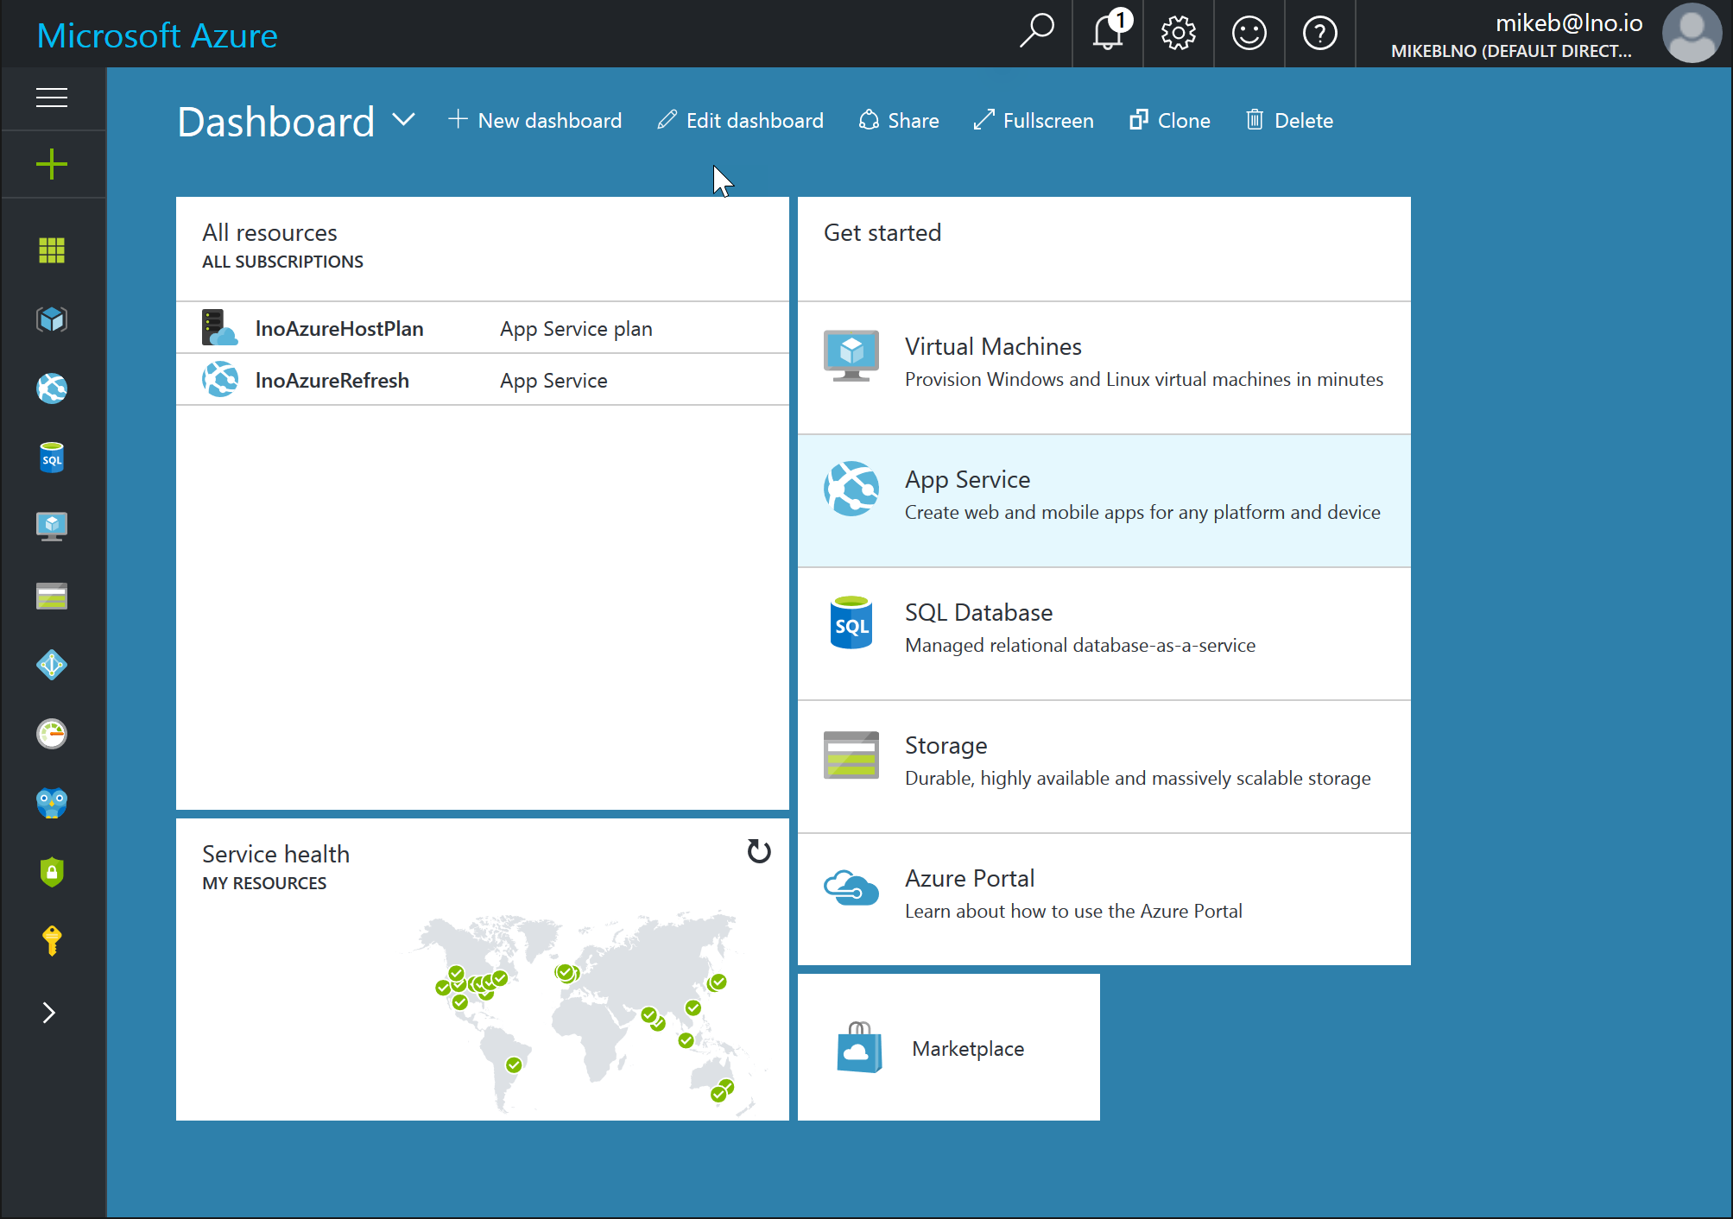
Modern Azure Portal
Blades are a vertical partition of content currently being viewed
Additional levels of detail can be drilled into with additional blades added to right
Customizable dashboard views allow you to pin what you need where you want it
Powerful search enables you to find anything by name or by type
Support provisioning with ARM
http://portal.azure.com

Slide 15
Understanding Azure Resources
App Services
Web, Mobile, Logic, or Flow Apps
App Service Plans
Managed compute infrastructure for your App Services
Hosting configuration
Resource Groups
Logical containers for organizing and managing Azure resources

Slide 16
Azure Resource Manager
JSON based service definition
Scriptable via PowerShell, .NET and other tools to provision services with specific settings
Repeatable!
New Portal is ARM focused as well as RBAC enabled

Slide 17
LAB
http://bit.ly/gabc17labs
Provision Subscription
Management Portal

Slide 18
Schedule
8:00 Setup
8:30 Welcome/Coffee/etc
9:00 Keynote Welcome to Azure
9:30 Azure Management tour (?)
10:00 App Services
11:00 Azure Functions
12:30 Docker & .NET Core
1:30 DevOps
2:30 Patterns
3:30 Raffle

Slide 19
Docker and Azure Container Service
MIKE BENKOVICH
mike@benko.com

Slide 20
Why microservices?
Traditional approach
Microservices approach
API
UI
Component Library 1
Component Library 2
Component Library 3
Data Access

Slide 21
Why microservices?
Traditional approach
Microservices approach
API
UI
Microservices approach
Component Library 1
Component Library 2
Component Library 3
Data Access

Slide 22
Microservices + Containers
Azure Container Service
Shopping cart service
.NET CORE
Catalog service
JAVA
Inventory service
RUBY
WEB APP
Shipping service
.NET CORE
Account service
PYTHON

Slide 23

Continuous Integration with Containers
Azure Container Service
Container based CI/CD with Visual Studio Team Services
Shopping cart service
.NET CORE
Azure Container Registry
Catalog service
JAVA
Inventory service
RUBY
WEB APP
Shipping service
.NET CORE
Account service
PYTHON
Visual Studio

Slide 24
Containers
Lightweight alternative to virtual machines
Smaller, less expensive, faster to start up, and self-contained
Virtual Machines
App
App
App
Libraries
Libraries
Libraries
Containers
Guest OS
Guest OS
Guest OS
App
App
App
Libraries
Libraries
Libraries
Hypervisor
Container Engine
Host Operating System
Operating System
Notes:
A virtual machine is -- well -- a virtualized machine created and managed by a hypervisor such as VirtualBox or Hyper-V. Even though a VM runs on a machine that has an operating system, each VM requires its own complete operating system, even if it's the same operating system as the host OS. VMs offer a very high degree of isolation, but at a cost: longer startup times, lower portability (ever tried to move a 127 GB virtual hard disk, or VHD, from one PC to another?), and higher memory requirements. Containers, by contrast, leverage the operating system that is already in place but offer nearly as much separation. RAM requirements are lower since the OS isn't being duplicated in each container, and cost is lower, too, because while cloud platforms typically charge for each VM, a single VM can host multiple container instances.

Slide 25

Docker
Leading open-source containerization platform
Supported natively in Azure
Docker containers wrap up a piece of software in a complete filesystem that contains everything it needs to run: code, runtime, system tools, system libraries – anything you can install on a server. This guarantees that it will always run the same, regardless of the environment it is running in
Notes:
Docker (www.docker.com) isn't the world's only containerization platform, but it is the most popular. It is free, open-source, and Linux-based, with Windows support (Windows Server 2016) in the works. It has earned massive mindshare in the developer community. And with Azure Container Service, you can deploy Docker containers to Azure with minimal effort. Moreover, Docker containers are easily moved between Azure and Amazon Web Services (AWS), affording developers portability between cloud platforms.

Slide 26
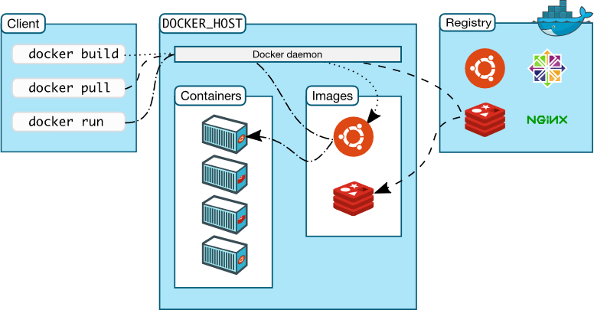
Docker Architecture
Notes:
Docker utilizes a client-server architecture. You execute Docker commands through a Docker client such as the Docker CLI or Kitematic.
The client uses REST commands to communicate with the Docker daemon running on a Docker host such as the Azure Container services.
These commands can be used to push, pull (docker pull), and create Docker images, to run them in containers, and to manage those containers.
Images can be built with the docker build command, and they can be stand-alone, or they can "inherit" from other images.
Images are stored in Docker registries, which can be public or private, local or remote.
Docker Hub is a popular public registry that is managed by Docker; it contains a "huge collection" of images that anyone may use.
The docker run command runs a container using an image as a template.

Slide 27
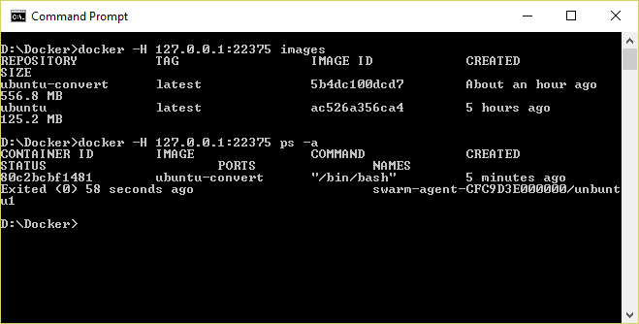
Docker CLI
Command-line interface for Docker, available for Linux, OS X, and Windows (available separately or as part of Docker Toolbox)
Notes:
The Docker Client, also known as the Docker CLI, is the primary tool you use to manage Docker containers. You can download container images from repositories such as Docker Hub, build container images, run container instances, list container images and instances, and much more. After connecting to Azure Container Service using SSH, you can use port forwarding to execute commands locally that act on an Azure Container Service running in the cloud. In this example, the -H switch used with the docker commands forwards commands sent to port 22375 on localhost to the Azure Container Services via SSH.

Slide 28
Running a Container
docker run -i -t ubuntu /bin/bash
Docker CLI command
Run container with interactive terminal
Pull "ubuntu" image from Docker Hub or local registry
Command to execute in the container
Notes:
This command pulls the image named "Ubuntu" from Docker Hub (or a local registry if the image is cached there) and runs it interactively in a container. "Interactively" means standard input, output, and error are connected locally so you can provide input to the container and see its output. Of course, you are not limited to the "Ubuntu" image. You can specify other images and even create images of your own with docker build. Where the container runs depends on the context. The container can run locally in a docker host (for example, a VM on Windows), or it can remotely if you connect to a remote Docker daemon (for example, one running in Azure) via SSH tunneling and use port forwarding to forward docker commands to the daemon.

Slide 29
Common Docker CLI Commands
docker run - Use an image to run a container
docker pull - Pull an image from a registry
docker build - Build a Docker image
docker images - List available Docker images
docker ps - List running Docker containers
docker exec - Execute a command in a container
docker stop - Stop a running container
Notes:
These are some of the most commonly used docker commands. You can also use docker push to push an image to a registry such as Docker Hub. Also, docker ps is often accompanied by a -a switch to list all containers, including those that are no longer running, while docker rm and docker rmi are used to delete (remove) containers and images, respectively. The docker build command uses a Dockerfile (a text file containing build commands) and a "context" -- for example, a specified directory in the file system -- to build Docker images.

Slide 30
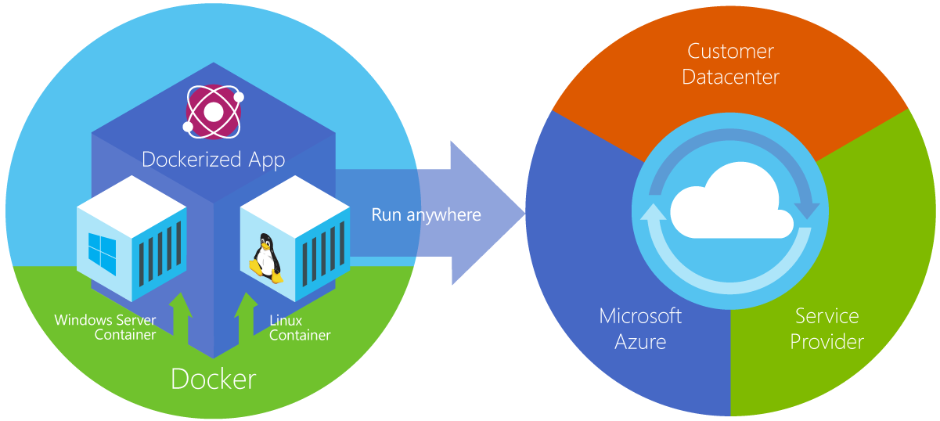
Azure Container Service
Provides robust, ready-to-use Docker hosting environment
Uses open-source orchestration tools (DC/OS and Swarm)
Notes:
From the documentation: "Azure Container Service makes it simpler for you to create, configure, and manage a cluster of virtual machines that are preconfigured to run containerized applications. It uses an optimized configuration of popular open-source scheduling and orchestration tools. This enables you to use your existing skills, or draw upon a large and growing body of community expertise, to deploy and manage container-based applications on Microsoft Azure." ACS supports Linux containers and Windows containers. The latter rely on Windows Server 2016.

Slide 31
Container Orchestration
Facilitates deployment and management of containers
Containers by design are intended to be deployed in large volumes with some applications using dozens to even thousands of containers
With this type of scale, automating container deployment and management with orchestration software becomes necessary
Azure Container service supports Kubernetes, DC/OS, and Docker Swarm
Notes:
Orchestration in the context of containers is the deployment and management of containers across infrastructure and networks. It provides the tools and software defined infrastructure needed to deploy containers. Containers by design are intended to be deployed in large volumes with some applications using dozen to even thousands of containers. With this type of scale, automating deployment and management of containers with Orchestration Software becomes necessary.

Slide 32
Container Clusters
Facilitate load balancing, scalability, and high availability
A cluster is composed of master nodes which control the orchestration, and agent nodes that host the containers
Notes:
A container cluster is intended to have redundancy for load balancing, scalability, and high availability. A cluster is composed of one or more Master Nodes which control the orchestration for scaling and delegation of tasks to the agents as well as provide monitoring. The Agent Nodes actually run the container loads.

Slide 33

Kubernetes
Open-source orchestration engine from Google
Provides a robust framework for container orchestration, yet remains lightweight and scalable
Supported by Azure Container Service and tightly integrated with ACS, allowing Kubernetes to modify deployments
Notes:
Kubernetes is an open-source platform for automating deployment, scaling, and operations of application containers across clusters of hosts, providing container-centric infrastructure.
With Kubernetes, you are able to quickly and efficiently respond to customer demand:
Deploy your applications quickly and predictably.
Scale your applications on the fly.
Seamlessly roll out new features.
Optimize use of your hardware by using only the resources you need.

Slide 34
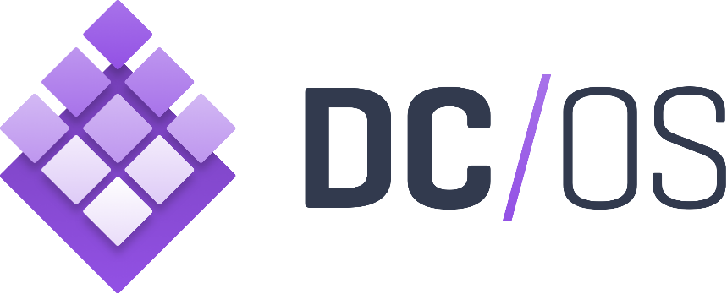
DC/OS
Datacenter Operating System built on Apache Mesos
Creates logical data centers and abstracts underlying hardware
Provides resources traditionally provided by infrastructure, including networking, DNS, and load balancing
Natively supported by Azure Container Service
Notes:
Datacenter Operating System is, as the name implies, an operating system for for a datacenter rather than for a phyiscal of virtual machine.
DC/OS abstracts away the underlying hardware from applications and provides much of the needed infrastructure that would otherwise come from multiple disparate services on traditional networks.
This enables operations and developers alike to deploy and maintain applications in a uniform fashion with less time and resources spent monitoring the supporting network and network services for those applications.

Slide 35
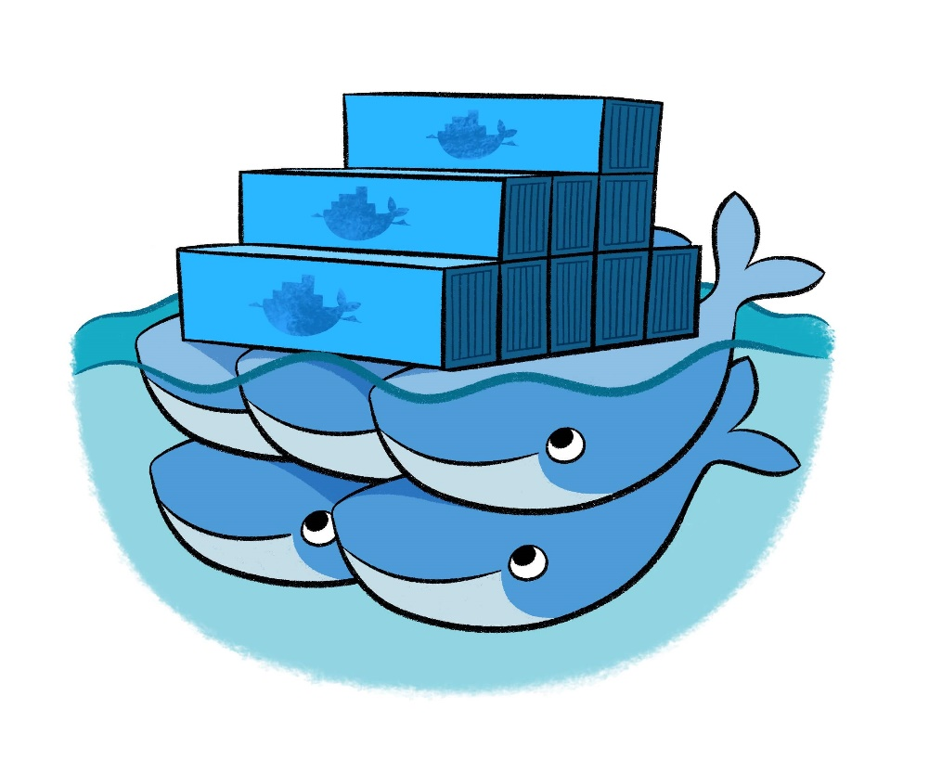
Docker Swarm
Docker’s own orchestration engine
Current releases of the Docker engine have “Swarm Mode” built in and can many of the same things that other orchestration engines do
Lacks a GUI, but makes up for it with tight integration with Docker
Natively supported by Azure Container Service
Notes:
Docker Swarm is the orchestration engine from Docker. It has tight integration with Docker, so many of the same paradigms and tools that used with Swarm seamlessly as well as some additional features like overlay networks and Docker services that can run multiple containers spread across multiple hosts. These containers can seamlessly communicate and rapidly scale.

Slide 36
demo
.NET Core
Docker

